Slide 1
Shopping Behaviour Analysis & Customer Segmentation
Applied Data Science
Assignment 2
Student ID: 5938ZKUW

Slide 2
Project Overview
Goal: Analyse customer shopping behaviour, visualize trends, and identify customer groups using K-Means clustering.
Objectives:
Understand customer characteristics and purchase behaviour
Explore patterns using visual analytics
Evaluate relationships between variables (correlation)
Segment customers using clustering
Provide insights for targeted marketing

Slide 3
Dataset Description
Feature Name | Description | Type
Age | Customer’s age in years | Numeric
Gender | Customer’s gender (Male/Female) | Categorical
Purchase Amount (USD) | Amount spent in the latest purchase | Numeric
Previous Purchases | Number of previous purchases made | Numeric
Review Rating | Average rating given by customer (1–5) | Numeric
Promo Code Used | Whether the customer used a promo code (Yes/No) | Categorical
Location (if available) | Region or store location of the customer | Categorical
Customer ID | Unique identifier for each record | Categorical (dropped before modeling)
Source: “Shopping Behavior Dataset” (updated 2025)
Domain: Retail / E-commerce Customer Behavior
Total Records: ~3,000 customer entries
Features: 8 columns (mix of demographic, behavioral, and transactional variables)
Data Type Mix: Numeric (int/float) + Categorical (Yes/No, Gender)

Slide 4
Data Cleaning & Preparation
Checked dataset shape and structure
Verified missing values → none found
Checked for duplicates → removed if present
Converted categorical values:
“Yes/No” → 1/0
Age grouped into 5 meaningful categories
Dropped irrelevant columns (Customer ID, Promo Code Used)

Slide 5
Summary statistics
Feature | Count | Mean | Std Dev | Min | 25% | 50% | 75% | Max
Customer ID | 3900 | 1950.50 | 1125.98 | 1 | 975.75 | 1950.50 | 2925.25 | 3900
Age | 3900 | 44.07 | 15.21 | 18 | 31.00 | 44.00 | 57.00 | 70
Purchase Amount (USD) | 3900 | 59.76 | 23.69 | 20 | 39.00 | 60.00 | 81.00 | 100
Review Rating | 3900 | 3.75 | 0.72 | 2.5 | 3.10 | 3.70 | 4.40 | 5.0
Subscription Status | 3900 | 0.27 | 0.44 | 0 | 0.00 | 0.00 | 1.00 | 1
Discount Applied | 3900 | 0.43 | 0.50 | 0 | 0.00 | 0.00 | 1.00 | 1
Promo Code Used | 3900 | 0.43 | 0.50 | 0 | 0.00 | 0.00 | 1.00 | 1
Previous Purchases | 3900 | 25.35 | 14.45 | 1 | 13.00 | 25.00 | 38.00 | 50

Slide 6
Summary Statistics
Customer Demographics
Age ranges from 18 to 70, with an average age of 44.
Distribution shows a balanced mix of younger and older customers.
Spending Behaviour
Purchase Amount ranges from $20 to $100.
Average purchase is $59.76, with median $60 → fairly symmetrical distribution.
Customer Engagement
Review Ratings average 3.75/5, indicating generally positive feedback.
Previous Purchases average around 25, suggesting moderate customer loyalty.
Marketing Features
27% of customers have an active subscription.
43% used a discount; 43% used a promo code
→ promotional tools are moderately used.
Data Readiness
Variables are consistent and numeric.
Binary values (Yes/No) converted to 1/0 for analysis.
Customer ID identified as non-informative → removed before clustering.

Slide 7
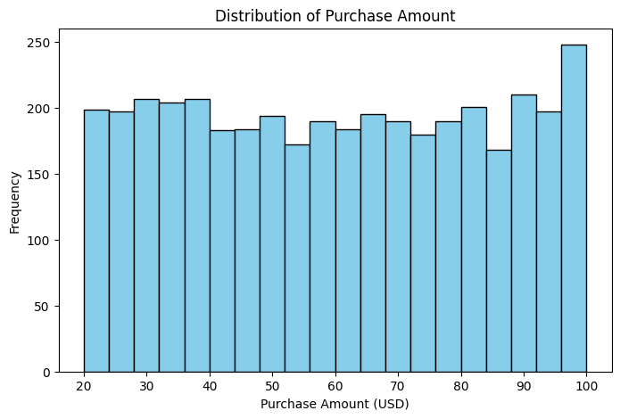
Distribution of Purchase Amount
The distribution is fairly uniform, indicating customers are spread across different spending levels.
A slight increase near the upper end (90–100 USD) suggests a segment of high-spending customers.
There are no extreme outliers, meaning purchases are consistent across the population.
This pattern supports using clustering — spending can help identify meaningful customer groups.

Slide 8
Preprocessing the data (Creating Age Groups)
Divided continuous age values into 5 meaningful age brackets (18–25, 26–35, 36–45, 46–55, 56–70).
Grouped customers by age bracket to simplify analysis and reduce noise.
Calculated aggregated metrics: average purchase amount, average age, previous purchases, ratings, discount rate, and subscription rate.
Counted the number of customers in each age group to understand segment size.
Enabled clearer visualization and prepared the dataset for correlation analysis and clustering.
Age Group | n_customers | avg_age | avg_purchase | avg_rating | avg_prev_purchases | discount_rate | sub_rate
18–25 | 502 | 22.05 | 60.74 | 3.83 | 25.13 | 0.434 | 0.271
26–35 | 742 | 30.41 | 59.76 | 3.74 | 24.76 | 0.436 | 0.264
36–45 | 729 | 40.43 | 59.31 | 3.75 | 25.17 | 0.414 | 0.263
46–55 | 753 | 50.52 | 60.58 | 3.71 | 25.42 | 0.433 | 0.304
56–70 | 1105 | 62.88 | 59.06 | 3.75 | 26.19 | 0.433 | 0.259

Slide 9
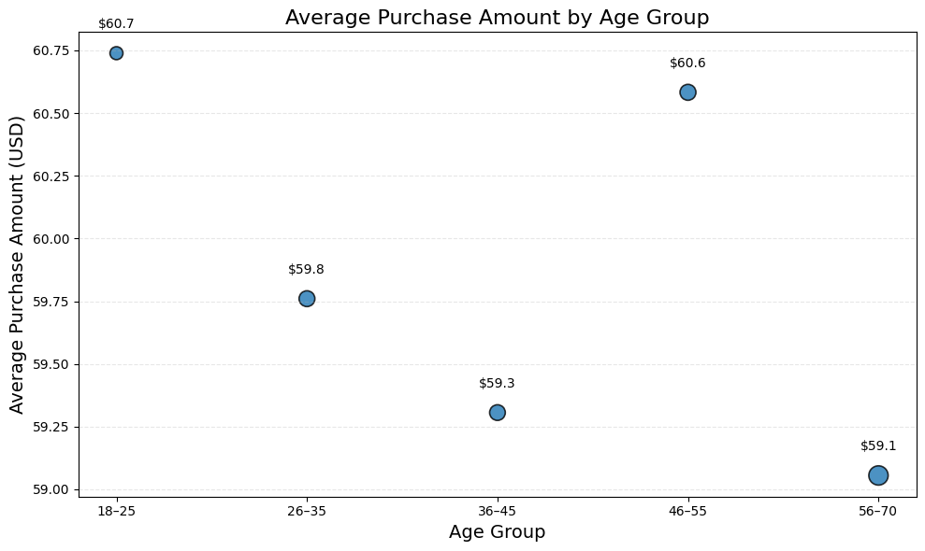
Scatter Plot: Average Purchase Amount by Age Group
Shows the relationship between Average Purchase Amount and Average Previous Purchases across age groups.
Age groups were created to reduce noise and make patterns clearer compared to individual-level data.
Each point represents one age group, summarizing customer behavior in that segment.
Reveals small but noticeable differences in spending and past purchase activity between age groups.
Helps identify which groups behave similarly, forming the basis for later clustering analysis.
Provides an early visual indication that age groups may fall into two main behavioral patterns.

Slide 10
Data preprocessing (Category-Level Aggregation0
Category | # Customers | Avg Age | Avg Purchase (USD) | Avg Rating | Avg Previous Purchases | Subscription Rate | Discount Rate
Accessories | 1240 | 44.22 | 59.84 | 3.77 | 25.73 | 0.269 | 0.438
Clothing | 1737 | 43.78 | 60.03 | 3.72 | 25.20 | 0.263 | 0.421
Footwear | 599 | 44.44 | 60.26 | 3.79 | 25.23 | 0.285 | 0.433
Outerwear | 324 | 44.31 | 57.17 | 3.75 | 24.96 | 0.281 | 0.444
Grouped the dataset by product category (Accessories, Clothing, Footwear, Outerwear).
Calculated average values for:
Age; Purchase Amount; Rating; Previous Purchases; Subscription Rate; Discount Rate.
Counted the number of customers per category.
Created a summary table showing how each category differs in customer behaviour.
This aggregation simplifies the data and makes category-level comparisons possible.

Slide 11
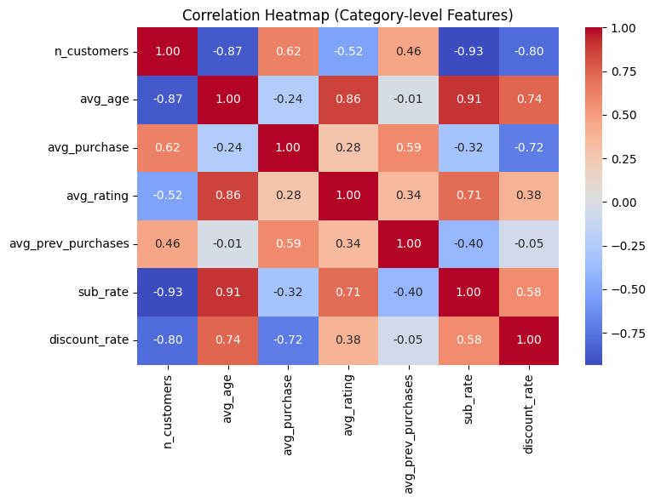
Category-Level Correlation Heatmap
Older customers subscribe more
→ Strong correlations: Age–Subscription (+0.91), Age–Rating (+0.86)
Discounts decrease spending
→ Avg purchase vs. discount rate (–0.72)
Higher repeat purchases = higher spend
→ Correlation (+0.59)
Customer volume doesn’t drive performance
→ More customers ≠ higher spend or satisfaction
Categories with lower discounts tend to show stronger revenue per customer

Slide 12
Data preprocessing (clustering)
Age Group | Avg Purchase (USD) | Avg Rating | Avg Previous Purchases | Subscription Rate | Discount Rate
18–25 | 60.648 | 3.816 | 24.634 | 0.263 | 0.433
26–35 | 59.760 | 3.735 | 24.760 | 0.264 | 0.435
36–45 | 59.306 | 3.751 | 25.170 | 0.263 | 0.414
46–55 | 60.583 | 3.712 | 25.420 | 0.304 | 0.433
56–70 | 59.055 | 3.751 | 26.193 | 0.259 | 0.433
We divided customers into age groups (18–25, 26–35, 36–45, 46–55, 56–70).
Used groupby to calculate key metrics for each segment.
Computed average purchase amount, rating, and previous purchases per age group.
Calculated subscription rate and discount usage rate for each group.
Produced a summary table showing behavioral differences between age segments.
This grouping provides a structured foundation for scatter plots and clustering analysis.

Slide 13
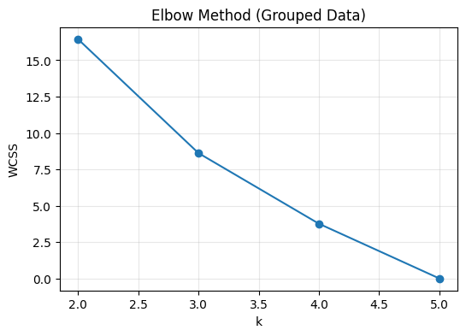
Elbow Method
The elbow method evaluates how WCSS decreases as the number of clusters (k) increases.
WCSS drops sharply from k = 2 to k = 3, showing major improvement in clustering quality.
After k = 3, the decrease becomes much smaller, indicating diminishing returns.
The “elbow point” appears around k = 2–3, where adding more clusters no longer provides significant benefit.
k = 2 is chosen as the optimal value because it provides clear, meaningful segmentation with minimal complexity.
Higher k values risk overfitting, especially given only five age groups in the dataset.

Slide 14
Silhouette Score
Measures how well each point fits within its cluster (cohesion) vs. others (separation).
Score range: –1 to +1 → higher = better cluster quality.
Our results:
k=2 → 0.111 (best)
k=3 → 0.110
k=4 → 0.063
Scores are low because we only have 5 age-group data points, limiting cluster separation.
k = 2 chosen as the optimal clustering since it yields the highest Silhouette Score.

Slide 15
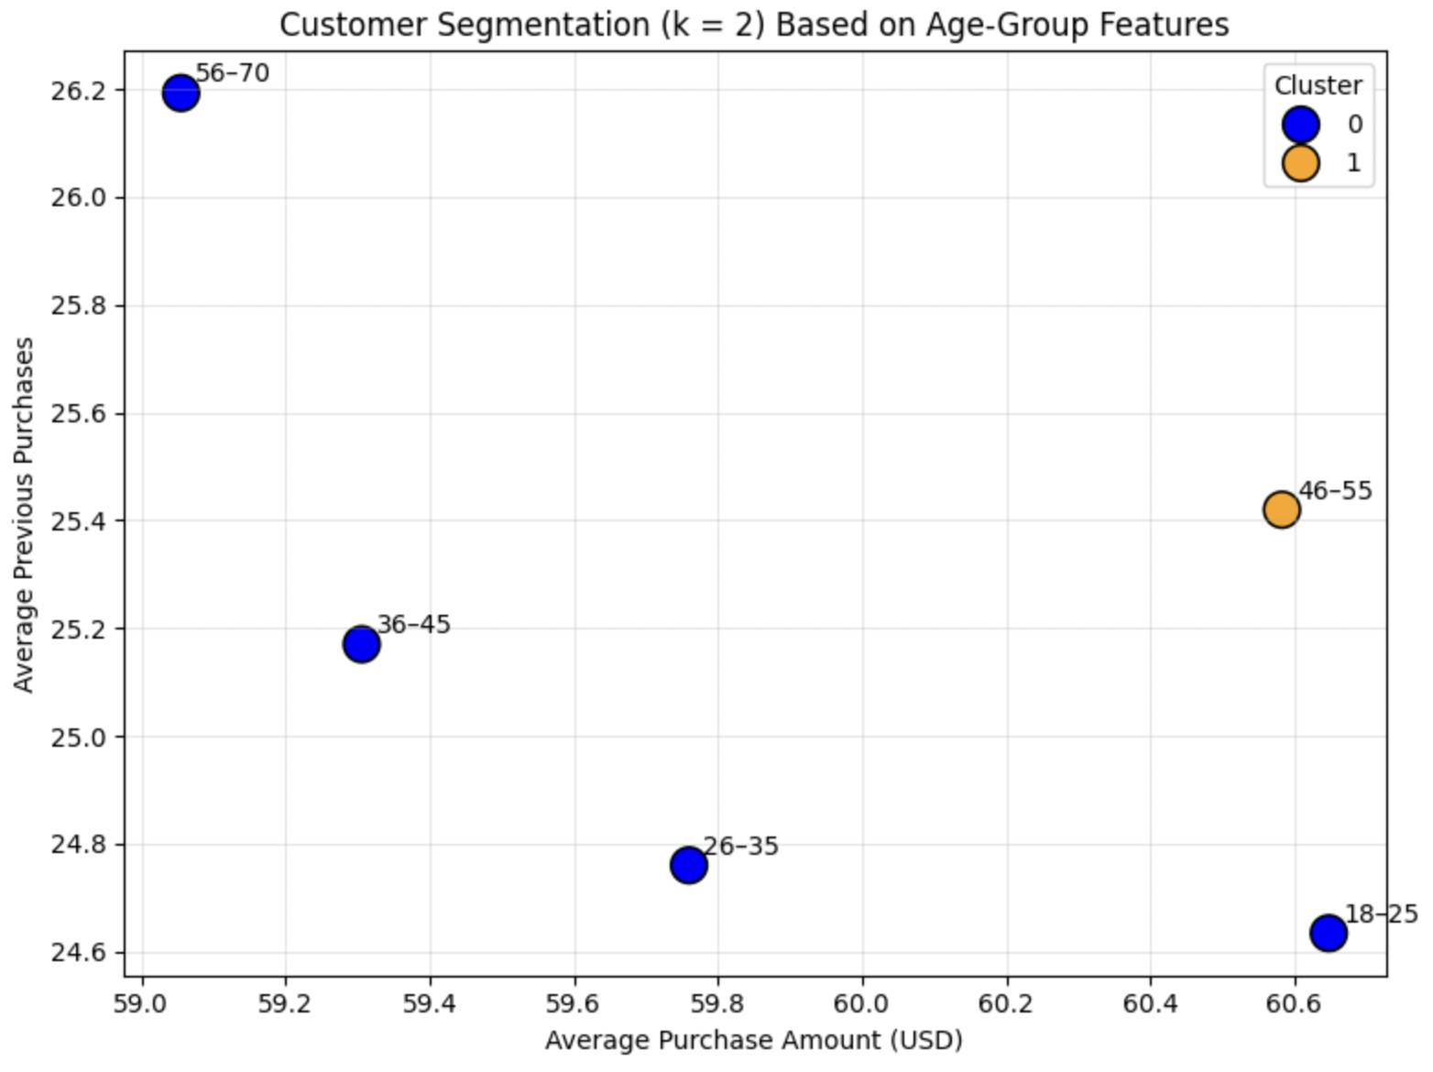
Scatter Plot (k = 2 Clusters)
k = 2 segmentation creates one main customer segment and one unique outlier segment (46–55).
This can be used to tailor marketing or promotional strategies to this specific age group.

Slide 16
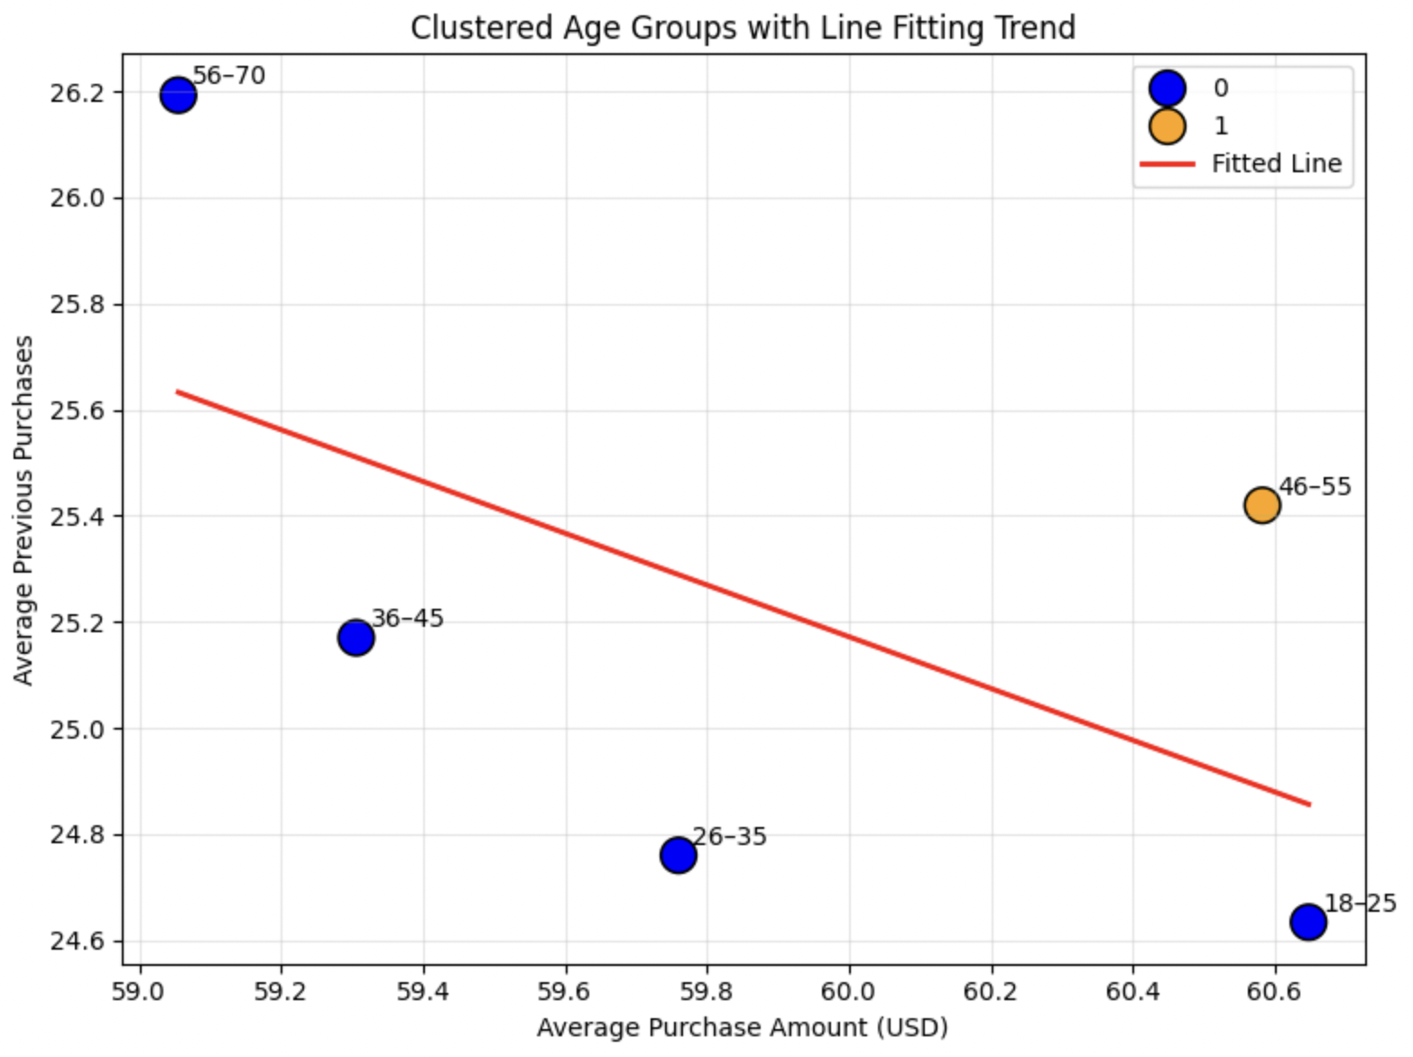
Clustered Age Groups with Fitted Line
This chart visualizes how Average Purchase Amount (x-axis) relates to Average Previous Purchases (y-axis) across age-group clusters.
The points are color-coded by cluster:
Blue = Cluster 0
Orange = Cluster 1 (only the 46–55 group)
A red regression line shows the overall trend between the two variables.
The fitted line helps visualize the general relationship between spending and past activity.
The cluster colors highlight distinct behavioral segments:
One broad cluster of typical shoppers.
One standout age group with unique purchasing patterns.

Slide 17
Conclusion
Cleaned and prepared the dataset, including handling missing values, duplicates, and creating Age Group categories.
Performed exploratory analysis to understand purchase behavior, ratings, previous purchases, subscription rates, and discount usage.
Grouped customers by age and computed key metrics (avg purchase, rating, previous purchases, subscription rate, discount rate).
Created a correlation heatmap showing relationships between category-level features (As average age increases, the subscription rate tends to increase too).
Applied K-means clustering and used Elbow Method + Silhouette Score → both indicated k = 2 as the best cluster count.
Visualized clusters and identified that 46–55 forms its own segment, while the rest behave similarly — helping define targeted marketing strategies.

